Slide 1
CSE 331: Microprocessor Interfacing and Embedded Systems
Lecture 3: ARM ISA (Assembly Language)

Slide 2
CISC & RISC
CISC: complex instruction set computer
original CPUs very simple
poorly suited to evolving high level languages
extended with new instructions
e.g. function calls, non-linear data structures, array bound checking, string manipulation
implemented in microcode
sub-machine code for configuring CPU sub-components
1 machine code == > 1 microcode
e.g. Intel X86 architecture

Slide 3
CISC & RISC
CISC introduced integrated combinations of features
e.g. multiple address modes, conditional execution
required additional circuitry/power
multiple memory cycles per instruction
over elaborate/engineered
many feature combinations not often used in practise
could lead to loss of performance
better to use combinations of simple instructions

Slide 4
CISC & RISC
RISC: reduced instruction set computer
return to simpler design
general purpose instructions with small number of common features
less circuitry/power
execute in single cycle
code size grew
performance improved
e.g. ARM, MIPS

Slide 5
ARM
Advanced RISC Machines
UK company
originally Acorn
made best selling BBC Microcomputer in 1980s
world leading niche processors
2015 market share:
85% of apps processors
65% of computer peripherals,
90% of hard-disk and SSD
95% of automotive apps processors

Slide 6
ARM
32 bit RISC processor architecture family
many variants:
A (Application), M (Microcontroller), R (Real Time), X (High Performance)
ARM does not make chips
licences the IP core (intellectual property) logic design to chip manufacturers

Slide 7
Books
general reference :
W. Hohl, ARM Assembly Language, CRC Press, 2009
ARM7TDMI
NB not Linux format
for Raspberry Pi:
B. Smith, Raspberry Pi Assembly Language Raspbian Hands On Guide (2nd Ed), 2014

Slide 8
References
ARM Cortex A processor:
https://silver.arm.com/download/Software/BX100-DA- 98001-r0p0-01rel3/DEN0013D_cortex_a_series_PG.pdf General Purpose IO:
https://www.raspberrypi.org/documentation/hardwar e/raspberrypi/bcm2835/BCM2835-ARM- Peripherals.pdf

Slide 9
Memory
Data
Address
8 bits
32 bits
Memory is arranged as a series of “locations”
Each location has a unique “address”
Each location holds a byte (byte-addressable)
e.g. the memory location at address 0x080001B0 contains the byte value 0x70, i.e., 112
The number of locations in memory is limited
e.g. 4 GB of RAM
1 Gigabyte (GB) = 2³⁰ bytes
2³² locations 🡺 4,294,967,296 locations!
Values stored at each location can represent either program data or program instructions
e.g. the value 0x70 might be the code used to tell the processor to add two values together
0xFFFFFFFF
701A0708
18
0x080001B0
0x080001AF
0x080001AE
0x080001AD
0x080001AC
0x00000000
Memory

Slide 10
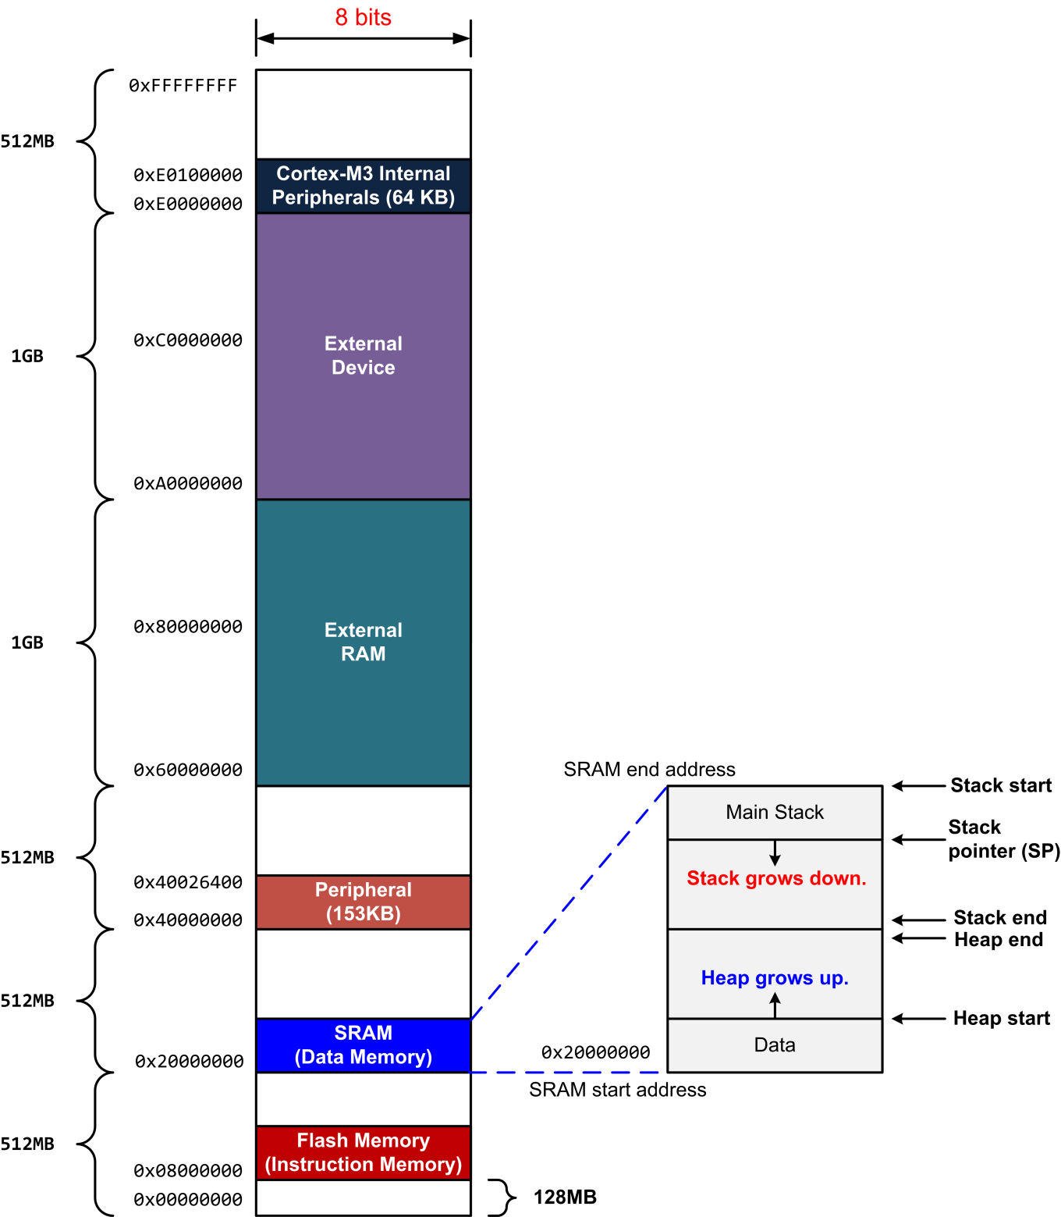
ARM M4 Memory Map

Slide 11
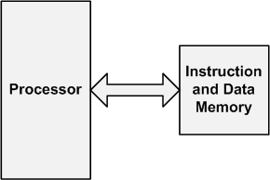
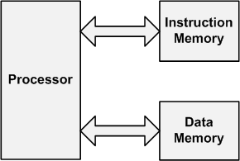
Computer Architecture
Von-Neumann
Harvard
Instructions and data are stored in the same memory.
Data and instructions are stored into separate memories.

Slide 12
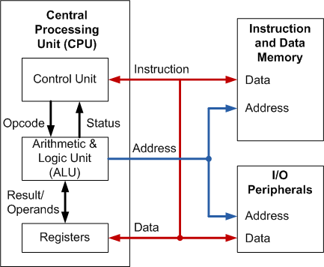
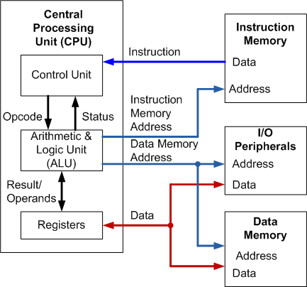
Computer Architecture
Von-Neumann
Harvard
Instructions and data are stored in the same memory.
Data and instructions are stored into separate memories.

Slide 13
ARM Cortex-M Series Family
Von-Neumann
Harvard
Instructions and data are stored in the same memory.
Data and instructions are stored into separate memories.
ARM
Cortex-M0
ARM
Cortex-M0+
ARM
Cortex-M3
ARM
Cortex-M4
ARMv6-M
ARMv6-M
ARMv7-M
ARMv7E-M
ARM
Cortex-M1
ARM
Cortex-M23
ARM
Cortex-M7
ARM
Cortex-M33
ARMv6-M
ARMv8-M
ARMv7E-M
ARMv8-M

Slide 14
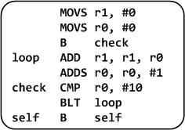
Levels of Program Code
C Program
Machine Program
Assembly Program
Assemble
0010000100000000
0010000000000000
1110000000000001
0100010000000001
0001110001000000
0010100000001010
1101110011111011
1011111100000000
1110011111111110
int main(void){
int i;
int total = 0;
for (i = 0; i < 10; i++) {
total += i;
}
while(1); // Dead loop
}
Compile
High-level language
Level of abstraction closer to problem domain
Provides for productivity and portability
Hardware representation
Binary digits (bits)
Encoded instructions and data
Assembly language
Textual representation of instructions

Slide 15
Memory
linear addressing
2 descending stacks
main stack
process stack – used by OS
all operations based on registers
must move data between registers & memory

Slide 16
Registers
16 * 32 bit registers
working registers
R0-R7 – low registers
R8-R12 – high registers
R13 – stack pointer (SP)
R14 - link register (LR)
R15 – program counter (PC)
PSR – program status register
bits for negative (N), zero (Z), carry (C), overflow (V)

Slide 17
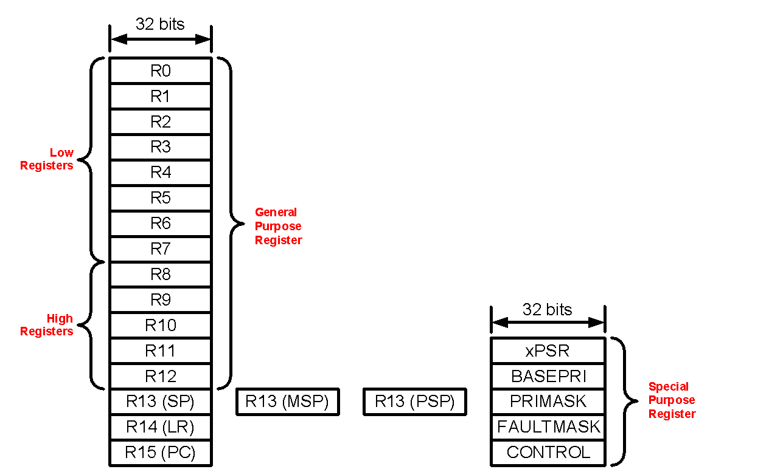
Registers–continued
Fastest way to read and write
Registers are within the processor chip
A register stores 32-bit value
STM32L has
R0-R12: 13 general-purpose registers
R13: Stack pointer (Shadow of MSP or PSP)
R14: Link register (LR)
R15: Program counter (PC)
Special registers (xPSR, BASEPRI, PRIMASK, etc)
Notes:
MSP- Main Stack Pointer, Process Stack Pointer

Slide 18
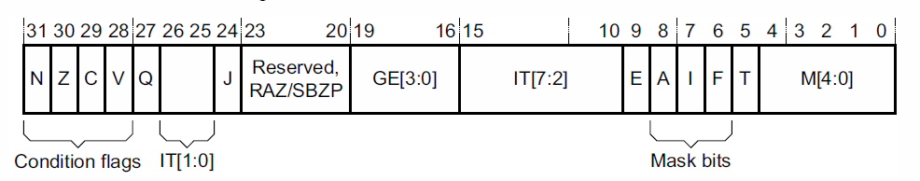
Program Status Registers
Condition code flags
N = Negative result from ALU
Z = Zero result from ALU
C = ALU operation Carried out
V = ALU operation oVerflowed
Sticky Overflow flag - Q flag
Architecture 5TE/J only
Indicates if saturation has occurred
J bit
Architecture 5TEJ only
J = 1: Processor in Jazelle state
Interrupt Disable bits.
I = 1: Disables the IRQ.
F = 1: Disables the FIQ.
T Bit
Architecture xT only
T = 0: Processor in ARM state
T = 1: Processor in Thumb state
Mode bits
Specify the processor mode

Slide 19
ARM Documenations
ARM versions: https://developer.arm.com/documentation/dui0472/m/Compiler-Command-line-Options/--cpu-name
ARM Jazelle State: https://developer.arm.com/documentation/ddi0406/c/System-Level-Architecture/The-System-Level-Programmers--Model/Jazelle-direct-bytecode-execution/Jazelle-state?lang=en

Slide 20
Data formats
word
32 bits
long
half word
16 bits
int
byte
8 bits
char

Slide 21
Programming approach
in high level programming:
identify variables & types
compiler maps these to memory & data representation
use of memory v registers invisible
in low level programming
must make explicit use of memory & registers
must choose data representation
registers much faster than memory
try to map variables to registers
what if more variables than registers...?

Slide 22
Instruction format
instruction Rd, Rn, operand₂
== Rd = Rn operation operand₂
instruction is a mnemonic
meaningful short form
reminds us what instruction does
Rd == destination register - R0..R15
Rn == operand register - may be optional
operand₂ == register or constant
constant == #number

Slide 23
MOV: move
MOV Rd, operand2 🡺
Rd = operand2
don’t update condition code flags
MOVS Rd, operand2
as MOV but update condition code flags
MOV Rd, #number 🡺
Rd = number
NB number <= 255 - more later

Slide 24
MVN: move with logical NOT
MVN Rd, operand2 🡺
Rd = operand2
don’t update condition code flags
performs a bitwise logical NOT operation on the operand2, and places the result into Rd.
MVN Rd, #number 🡺
Rd = !number

Slide 25
Label
Any instruction can be associated with a label
Example:
start: ADD r0,r1,r2 ; a = b+c next: SUB r1,r1,#1 ; b--
In fact, every instruction has a label regardless if the programmer explicitly names it
The label is the address of the instruction
A label is a pointer to the instruction in memory

Slide 26
Label
Therefore, the text label doesn‟t exist in binary code
relative to program counter (PC)
turned into PC + offset in machine code
may start with _ such as _global

Slide 27
System calls
SWI 0 == software interrupt to call function
parameters in R0-R2
system function number in R7
e.g. exit is 1
NB shell variable $? is R0 so:
echo $? == display R0

Slide 28
Layout
usual to precede instruction with a tab
comment is: @ text // text
large comment: /*............*/

Slide 29
Program skeleton
.global _start
_start:
@ program code here
_
MOV | R0, | #65 | @ | arbitrary | value
MOV | R7, | #1
SWI | 0
.global _start
assembler directive
entry point _start
is visible externally

Slide 30
Running assembler programs
file.s == assembly language source
$ as -o file.o file.s
assemble file.s to file.o
$ ld -o file file.o
create executable file from file.o
$ ./file
run executable in file from _start
$ echo $?
display R0

Slide 31
Example: exit
• $ $ | suppose exit.s is basic start program as -o exit.o exit.s ld -o exit exit.o
$ | ./exit
$ | echo $?
65

Slide 32
ADD: addition
ADD Rd, Rn, operand₂ 🡺
Rd = Rn+operand₂
ADD Rd, operand₂ 🡺 Rd =Rd+operand₂
ADDC
add with carry
like ADD + carry flag
ADDS/ADDCS
like ADD/ADDC but set condition code flags

Slide 33
SUB: subtraction
SUB Rd, Rn, operand₂ 🡺
Rd = Rn-operand₂
SUB Rd, operand₂ 🡺 Rd =Rd-operand₂ SBC
subtract with carry
like SUB -1 if carry flag not set
SUBS/SBCS
like SUB/SUBC but set condition code flags

Slide 34
RSB: reverse subtraction
RSB Rd, Rn, operand₂ 🡺
Rd = operand₂-Rn
RSB Rd, operand₂ 🡺
Rd =operand₂ -Rd

Slide 35
Multiplication
In ARM, we multiply registers, so:
32-bit value x 32-bit value = 64-bit value
Syntax of Multiplication (signed):
MUL register1, register2, register3
Built in multiplication MUL
{Rd, } Rn,operand₂ 🡺 Rd = Rn*operand₂
NB Rd cannot be an operand

Slide 36
Multiplication
Example:
in C:
in MIPS:
a = b * c;
let b be r2; let c be r3; and let a be r0 and r1 (since it may be up to 64
bits)
MUL r0, r2, r3 ; b*c only 32 bits stored
Note: Often, we only care about the lower half of the product.
SMULL r0,r1,r2,r3 ; 64 bits in r0:r1

Slide 37
Multiply and Divide
There are 2 classes of multiply - producing 32-bit and 64-bit results
32-bit versions on an ARM7TDMI will execute in 2 - 5 cycles
MUL r0, r1, r2
MLA r0, r1, r2, r3
; r0 = r1 * r2
; r0 = (r1 * r2) + r3
64-bit multiply instructions offer both signed and unsigned versions
For these instruction there are 2 destination registers
[U|S]MULL r4, r5, r2, r3
[U|S]MLAL r4, r5, r2, r3
; r5:r4 = r2 * r3
; r5:r4 = (r2 * r3) + r5:r4
Most ARM cores do not offer integer divide instructions
Division operations will be performed by C library routines or inline shifts

Slide 38
Instruction Summary So far
In ARM Assembly Language:
Registers replace C variables
One Instruction (simple operation) per line
Simpler is Better
Smaller is Faster
Instructions so far:
ADD, SUB, RSB, MUL, MULA, [U|S]MULL, [U|S]MLAL
Registers:
Places for general variables: r0-r12

Slide 39
Expressions
for:
var₁ = var₂ op var₃
with: var₁ in R₁ var₂ in R₂ var₃ in R₃
🡺 op R₁,R_{2,}R₃
e.g.
x = y*z; 🡺
@ | x | == | R1
@ | y | == | R2
@ | z | == | R3
MUL R1,R2,R3

Slide 40
Expressions
for:
var₁ = var₂ op₁ var₃ op₂ var₄
if op₁ and op₂ have same precedence
or op₁ has higher precedence than op₂ 🡺
op₁ R₁,R_{2,}R₃ op₂ R₁,,R₄
e.g.
x = y*z-a; 🡺
...
@ a == R4 MUL R1,R2,R3 SUB R1,R4

Slide 41
Expressions
for:
var₁ = var₂ op₁ var₃ op₂ var₄
if op₂ has higher precedence than op₁
must evaluate op2 expression in new register🡺
op₂ R_{i},R_{3,}R₄ op₁ R₁,,R₂,R_{i}
e.g.
x = y+z*a; 🡺
MUL R5,R3,R4 ADD R1,R2,R5
e.g.
x = y*(z+a) 🡺
ADD R5,R3,R4 MUL R1,R2,R5

Slide 42
CMP: compare
CMP Rd, operand₂
subtract operand₂ from Rd BUT ...
... do not modify Rd
– otherwise same as SUBS
update Z, N, C, V flags
CMN Rd, operand₂
add operand₂ to Rd BUT ...
... do not modify Rd
otherwise same as ADDS
update Z, N, C, V flags

Slide 43
Flags
N – 1 if result <0; 0 otherwise
Z – 1 if result =0; 0 otherwise
C – 1 if result led to carry; 0 otherwise
– i.e. X+Y > 2³²
– i.e. X-Y >= 0

Slide 44
Flags
V – 1 if result led to overflow; 0 otherwise
(-) == negative
(+) == positive
– i.e. (-)X+(-)Y > 0
– i.e. (+)X+(+)Y < 0
– i.e. (-)X-(+)Y > 0
– i.e. (+X)-(-Y) < 0

Slide 45
B: branch
B label
branch to label
i.e. reset PC to address for label
Bcond label
branch on condition to label

Slide 46
C Decisions: if Statements
if statements in C
if (condition) clause
if (condition) clause1 else clause2
Rearrange 2nd if into following:
if (condition) goto L1;
clause2;
goto L2; L1: clause1;
L2:
Not as elegant as if-else, but same meaning

Slide 47
ARM goto Instruction Conversion
The simplest control instruction is equivalent to a C goto statement
goto label (in C) is the same as:
B label (in ARM)
B is shorthand for “branch”. This is called an unconditional branch meaning that the branch is done regardless of any conditions.
There are also conditional branches

Slide 48
Condition
suffix | flags
EQ == equal | Z=1
NE == not equal | Z=0
CS/HS == carry set/ higher or same - unsigned | C=1
CC/LO == carry clear/lower - unsigned | C=0
MI == negative | N=1
PL == positive or 0 | N=0
VS == overflow | V=1
VC == no overflow | V=0

Slide 49
Condition
suffix | flags
HI == higher - unsigned | C=1 & Z=0
LS == lower or same - unsigned | C=0 or Z=1
GE == greater than or equal - signed | N=V
LT == less than - signed | N!=V
GT == greater than - signed | Z=0 & N=V
LE == less than or equal, signed | Z=1 or N!=V
AL == any value | default if not cond

Slide 50
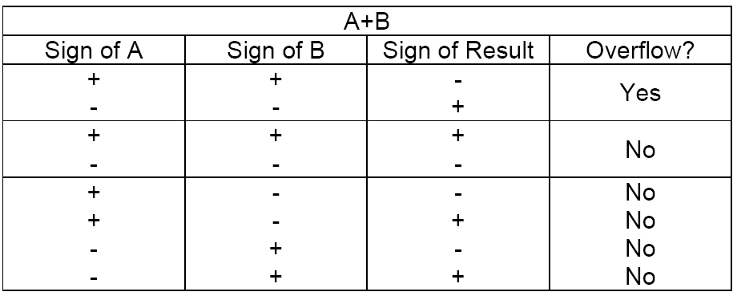
Overflow Detection
One way to detect overflow is to check whether the sign bit is consistent with the sign of the inputs when the two inputs are of the same sign – if you added two positive numbers and got a negative number, something is wrong, and vice versa.

Slide 51
ARM BRANCH Instructions
ARM also has variants of the branch instruction that only goto the label if a certain condition is TRUE
Examples:
BEQ | label | ; | BRANCH | EQUAL
BNE | label | ; | BRANCH | NOT EQUAL
BLE | label | ; | BRANCH | LESS THAN EQUAL
BLT | label | ; | BRANCH | LESS THAN
BGE | label | ; | BRANCH | GREATER THAN EQUAL
BGT | label | ; | BRANCH | GREATER THAN
Plus more …
The condition is T/F based upon the fields in the Program Status Register

Slide 52
Example: multiply by adding
int x;
int y;
int m;
x = 3;
y = 10;
m = 0;
while(y!=0)
{ m = m+x;
y = y-1;
}
.global _start
_start:
MOV R1, MOV R2, MOV R3, _loop: |  | #0x03 #0x0a #0x00
CMP | R2,#0x00
BEQ | _exit
ADD | R3, R1
SUB | R2, #0x01
B | _loop

Slide 53
Example: multiply by adding
#m=x*y
int x; int y; int m;
x = 8;
y = 10;
m = 0;
while(y!=0)
_exit:
MOV MOV SWI | R0, R7, 0 | R3 #1
...
$ echo $?
12
{ | m | = | m+x;
 | y | = | y-1;
}

Slide 54
Data directives & constants
.data
start of sequence of data directives
usually after instuctions program
.equ label, value
define constant
associate label with value
use #label as operand₂ to get value

Slide 55
Example: multiply by adding
m == x*y int x; int y; int m;
x = 8;
y = 10;
m = 0;
while(y!=0)
{ m = m+x; y = y-1;
}
.global _start
_start:
MOV MOV |  | R1, R2, | #X #Y
MOV |  | R3, | #0x00
_loop:
CMP | R2,#0x00
BEQ | _exit
ADD | R3, R1
SUB | R2, #0x01
B | _loop

Slide 56
Example: multiply by adding
m=x*y
int x; int y; int m;
x = 8;
y = 10;
m = 0;
while(y!=0)
_exit:
MOV MOV SWI | R0, R7, 0 |  | R3 #1
.data
.equ | X, | 3
.equ | Y, | 4
...
{ | m | = | m+x;
 | y | = | y-1;
}
$ echo $? 12

Slide 57
Tracing and debugging
gdb - GNU debugger
assemble with -g flag
run program from gdb
$ ./file
gdb file
...
(gdb) command
$ as | -g | -o | file.o | file.s
$ ld | -o | file | file.o

Slide 58

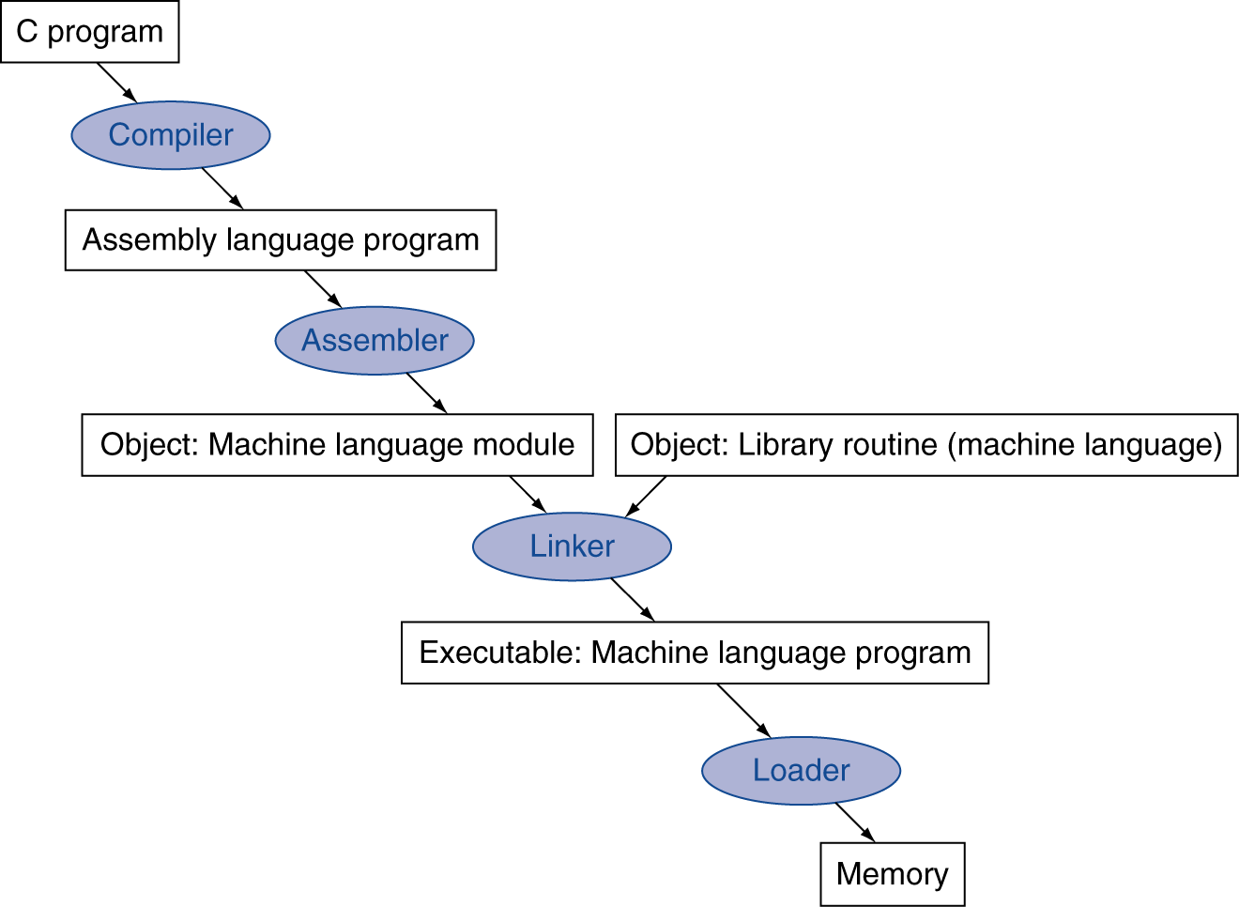
Translation and Startup
Many compilers produce object modules directly
§2.12 Translating and Starting a Program
Static linking
UNIX: C source files are named x.c, assembly files are x.s, object files are named x.o, statically linked library routines are x.a, dynamically linked library routes are x.so, and executable fi les by default are called a.out.
MS-DOS uses the .C, .ASM, .OBJ, .LIB, .DLL, and .EXE to the same effect.

Slide 59
Tracing and debuggging
q(uit) - return to shell
l(ist) - show program - may need to press return
r(un) - run program
b(reak) number - set breakpoint at line
number
program pauses at breakpoint
can set multiple breakpoints
can also set break points at labels & addresses

Slide 60
Tracing and debuggging
i(nfo) r - show registers
c(continue) - continue execution after breakpoint
s(tep) - execute next instruction
i(info) b - show breakpoints
d(delete) number - remove breakpoint
number

Slide 61
Tracing and debugging
to trace
set breakpoint at start of program
step & show registers
to debug
set breakpoints at salient points in program
e.g. at start or ends of loops
continue/step & show registers

Slide 62
Tracing and debugging
e.g. suppose mult program is in mult.s
$ as -g -o mult.o mult.s
$ ld -o mult mult.s
$ gdb mult
8 | CMP | R2,#0x00
9 | BEQ | _exit
10 | ADD | R3, R1
(gdb)
11 | SUB | R2, #0x01
12 | B | _loop
...
(gdb) | l
1 | .global |  | _start
2
3 _start:
4 |  | MOV | R1, | #X
5 |  | MOV | R2, | #Y
6 |  | MOV | R3, | #0x00
7 _loop:
13 _exit: 14
15
16
17
18 .data
MOV R0, R3 MOV R7, #1
SWI 0
.equ X, 3
.equ Y, 4
(gdb)

Slide 63
Tracing & debugging
(gdb) b _start Breakpoint 1 at 0x805b: file mult.s, line 5 (gdb) r
...
5 MOV R2, #Y
(gdb) i r
(gdb) i r
r0 | 0x0 | 0
r1 | 0x3 | 3
r2 | 0x0 | 4
r3 | 0x0 | 0
...
(gdb) | b 12
r0 | 0x0 | 0
r1 | 0x3 | 3
r2 | 0x0 | 0
r3 | 0x0 | 0
Breakpoint 2 at 0x8070: file mult.s, line 12 (gdb) c
...
12 B _loop
(gdb) s 6
MOV R, #0

Slide 64
Tracing & debugging
(gdb) i r
(gdb) c
r0 | 0x0 | 0
r1 | 0x3 | 3
r2 | 0x0 | 3
r3 | 0x0 | 3
...
(gdb) | c
...
12 | B | _loop
...
12 | B | _loop
(gdb) | i r
r0 | 0x0 | 0
r1 | 0x3 | 3
r2 | 0x0 | 1
r3 | 0x0 | 9
...
(gdb) i r
(gdb) c
... 12
r0 r1 r2 r3
...
0x0 0x3 0x0 0x0
0
3
2
6
B _ loop

Slide 65
Tracing & debugging
(gdb) | i r
r0 | 0x0 | 0
r1 | 0x3 | 3
r2 | 0x0 | 0
r3 | 0x0 | 12
...
(gdb) | c
...
[Inferior 1 (process 2614) exited with code 014] (gdb) q
$

Slide 66
NOP: no operation
NOP
do nothing
use for padding/layout
no cost

Slide 67
Compiling C if into ARM
Compile by hand
if (i == j) f=g+h;
else
f=g-h;
(true) i == j
(false) i != j
i == j?
f=g+h |  |  | f=g-h
Exit
Use this mapping:
f: r0, g: r1, h: r2, i: r3, j: r4

Slide 68
Comparison Instructions
In order to perform branch on the “==“ operation we need a new instruction
CMP – Compare: subtracts a register or an immediate value from a register value and updates condition codes
Examples:
CMP | r3, | #0 | ; | set | Z | flag | if | r3 | == | 0
CMP | r3, | r4 | ; | set | Z | flag | if | r3 | == | r4
All flags are set as result of this operation, not just Z.

Slide 69
Compiling C if into ARM
Compile by hand
if (i == j) f=g+h; else f=g-h;
(true) i == j
(false) i != j
i == j?
f=g+h |  |  | f=g-h
Final compiled ARM code:
CMP r3, r4 ; Z = 1 if i==j BEQ True
Exit
; goto True when i==j
 | SUB B | r0,r1,r2 Fin | ; ; | f=g-h(false) goto Fin
True: | ADD | r0,r1,r2 | ; | f=g+h (true)
Fin
Note: Compiler automatically creates labels to handle decisions (branches) appropriately. Generally not found in C code.

Slide 70
Loops in C/Assembly
Simple loop in C;
do{
g--;
i = i + j;} while (i != h);
Rewrite this as:
Loop: g--;
i = | i | + | j;
if | (i | != | h) | goto Loop;
Use this mapping:
g: r1, h: r2,i: r3, j:r4

Slide 71
Loops in C/Assembly
Final compiled ARM code:
Loop | SUB | r1,r1,#1 | ; | g--
 | ADD | r3,r3,r4 | ; | i=i+j
 | CMP | r3,r2 | ; | cmp i,h
BNE |  | Loop | ; ; | goto Loop if i!=h

Slide 72
Inequalities in ARM
Until now, we‟ve only tested equalities
(== and != in C). General programs need to test < and
> as well.
Use CMP and BLE, BLT, BGE, BGT
Examples:
if | (f | < | 10) | goto | Loop; => | CMP | r0,#10
 |  |  |  |  |  | BLT | Loop
if | (f | >= | i) | goto | Loop; => | CMP | r0,r3
 |  |  |  |  |  | BGE | Loop

Slide 73
Loops in C/Assembly
There are three types of loops in C:
while
do… while
for
Each can be rewritten as either of the other two, so the method used in the previous example can be applied to while and for loops as well.
Key Concept: Though there are multiple ways of writing a loop in ARM, conditional branch is
key to decision making

Slide 74
Example: The C Switch Statement
Choose among four alternatives depending on whether k has the value 0, 1, 2 or 3. Compile this C code:
switch | (k) {
case | 0: f=i+j; | break; | /* | k=0*/
case | 1: f=g+h; | break; | /* | k=1*/
case | 2: f=g–h; | break; | /* | k=2*/
case } | 3: f=i–j; | break; | /* | k=3*/
hfghdfghhhhhhhhhhghfghfghhhhhhhhhh

Slide 75
Example: The C Switch Statement
This is complicated, so simplify.
Rewrite it as a chain of if-else statements, which we already know how to compile:
if(k==0) f=i+j;
else if(k==1) f=g+h; else if(k==2) f=g–h;
else if(k==3) f=i–j;
Use this mapping:
f: $r0, g: $r1, h: $r2, i: $r3, j: r4, k: $r5

Slide 76
Example: The C Switch Statement
CMP r5,#0 BNE L1
; compare k, 0
; branch k!=0
ADD B |  | r0,r3,r4 Exit | ; ; | k==0 end | so of | f=i+j case so |  | Exit
L1 | CMP | r5,#1 | ; | compare |  | k, | -1
 | BNE | L2
ADD |  | r0,r1,r2 | ; | k==1 | so | f=g+h
B |  | Exit | ; | end | of | case so |  | Exit
L2 | CMP | r5,#2 | ; | compare |  | k, | 2
 | BNE | L3 | ; | branch |  | k!=2
 | SUB | r0,r1,r2 | ; | k==2 so |  | f=g | -h
 | B | Exit | ; | end of |  | case | so Exit
L3 | CMP | r5,#3 | ; | compare |  | k, | 3
 | BNE | Exit | ; | branch |  | k!=3
 | SUB | r0,r3,r4 | ; | k==3 so |  | f=i | -j
Exit:

Slide 77
Predicated Instructions
All instructions can be executed conditionally. Simply add {EQ,NE,LT,LE,GT,GE, etc.} to end
C source code
ARM instructions
unconditional
conditional
if { | (r0 |  | == | 0) |  |  | CMP BNE | r0, #0 else |  |  |  | CMP r0, #0 ADDEQ r1, |  | r1, | #1
r1 |  | = | r1 | + | 1; | ADD |  | r1, | r1, | #1 | ADDNE |  | r2, | r2, | #1
} else { r2 } |  | = | r2 | + | 1; | B end else: ADD r2, end ... |  |  | r2, | #1 | ...
▪ | 5 instructions | ▪ | 3 instructions
▪ | 5 words | ▪ | 3 words
▪ | 5 or 6 cycles | ▪ | 3 cycles

Slide 78
Expressions
draw expression tree
allocate registers to nodes
from bottom left
if expression in assignment then start with register for destination variable
accumulate into register for left operand
can re-use any register whose value is no longer required

Slide 79
Example: Pythagoras
int | x; | /* | R1 | */
int | y; | /* | R2 | */
int | z; | /* | R3 | */
int | p; | /* | R4 | */
==
+
*
x = 3;
y = 4;
z = 5;
if(x*x+y*y==z*z) p=1;
else p=0;
z
z
*
*
x
x y
y

Slide 80
Example: Pythagoras
int | x; | /* | R1 | */
int | y; | /* | R2 | */
int | z; | /* | R3 | */
int | p; | /* | R4 | */
==
+
*
x = 3;
y = 4;
z = 5;
if(x*x+y*y==z*z) p=1;
else p=0;
z
z
*
*
R5
x
x y
y

Slide 81
Example: Pythagoras
int | x; | /* | R1 | */
int | y; | /* | R2 | */
int | z; | /* | R3 | */
int | p; | /* | R4 | */
==
+
*
x = 3;
y = 4;
z = 5;
if(x*x+y*y==z*z) p=1;
else p=0;
z
z
*
*
R5
R6
x
x y
y

Slide 82
Example: Pythagoras
int | x; | /* | R1 | */
int | y; | /* | R2 | */
int | z; | /* | R3 | */
int | p; | /* | R4 | */
==
+ R5
*
x = 3;
y = 4;
z = 5;
if(x*x+y*y==z*z) p=1;
else p=0;
z
z
*
*
R5
R6
x
x y
y

Slide 83
Example: Pythagoras
int | x; | /* | R1 | */
int | y; | /* | R2 | */
int | z; | /* | R3 | */
int | p; | /* | R4 | */
==
+ R5
*
R6
x = 3;
y = 4;
z = 5;
if(x*x+y*y==z*z) p=1;
else p=0;
z
z
*
*
R5
R6
x
x y
y

Slide 84
Example: Pythagoras
int | x; | /* | R1 | */
int | y; | /* | R2 | */
int | z; | /* | R3 | */
int | p; | /* | R4 | */
==
CMP
+ R5
*
R6
x = 3;
y = 4;
z = 5;
if(x*x+y*y==z*z) p=1;
else p=0;
z
z
*
*
R5
R6
x
x y
y

Slide 85
Example: Pythagoras
int x; int y; int z; int p; x = 3;
y = 4;
z = 5;
if(x*x+y*y==z*z) p=1;
else p=0;
.global _start
_start:
MOV | R1, | #X
MOV | R2, | #Y
MOV | R3, | #Z
MUL | R5, | R1, | R1
MUL | R6, | R2, | R2
ADD | R5, | R6
MUL | R6, | R3, | R3
CMP | R5, | R6
BEQ | _same
MOV | R4, #0
B _exit
MOV R4, #1
_same:

Slide 86
Example: Pythagoras
int x; int y; int z; int p; x = 3;
y = 4;
z = 5;
if(x*x+y*y==z*z) p=1;
else p=0;
_exit:
MOV | R0, | R4
MOV | R7, | #1
SWI | 0
3
.data
.equ X,
.equ | Y, | 4
.equ | Z, | 5

Slide 87
See a Program Runs
C Code
Assembly Code
int sum(void){
int a = 0;
int b = 1;
int c;
c = a + b;
return c;
}
MOVS r1, #0x00 ; int a = 0
MOVS r2, #0x01 ; int b = 1
ADDS r3, r1, r2 ; c = a + b
MOVS r0, r3 ; set return value
BX lr ; return
compiler
assembler
Machine Code
0010000100000000
0010001000000001
0001100010001011
0010000000000000
0100011101110000
2100
2201
188B
2003
4770
; MOVS r1, #0x00
; MOVS r2, #0x01
; ADDS r3, r1, r2
; MOVS r0, r3
; BX lr
In Binary
In HEX

Slide 88
Program Execution
Program Counter (PC) is a register that holds the memory address of the next instruction to be fetched from the memory.
Memory Address
1. Fetch instruction at PC address
4770 2000
188B
2201
2100
0x080001B4
0x080001B2
0x080001B0
0x080001AE
0x080001AC
PC
3. Execute the instruction
2. Decode the instruction
PC = 0x080001B0
Instruction = 188B

Slide 89
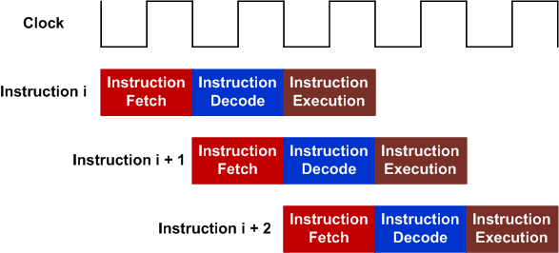
Three-state pipeline: Fetch, Decode, Execution
Pipelining allows hardware resources to be fully utilized
One 32-bit instruction or two 16-bit instructions can be fetched.
Pipeline of 32-bit instructions

Slide 90
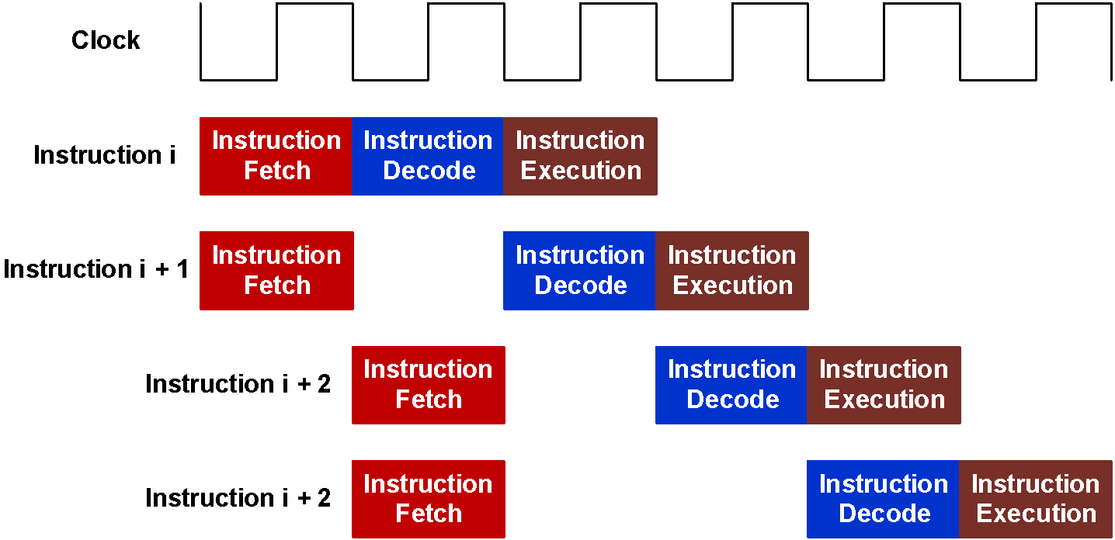
Three-state pipeline: Fetch, Decode, Execution
Pipelining allows hardware resources to be fully utilized
One 32-bit instruction or two 16-bit instructions can be fetched.
Pipeline of 16-bit instructions

Slide 91
Machine codes are stored in memory
Data
Address
r15
pc
0xFFFFFFFF
r14
lr
r13
sp
r12
r11
r10
r9
4770 2000
188B
2201
2100
0x080001B4
0x080001B2
0x080001B0
0x080001AE
0x080001AC
r8
ALU
r7
r6
r5
r4
r3
r2
r1
r0
0x00000000
Registers
CPU
Memory

Slide 92
Fetch Instruction: pc = 0x08001AC Decode Instruction: 2100 = MOVS r1, #0x00
Data
Address
r15
0x080001AC
pc
0xFFFFFFFF
r14
lr
r13
sp
r12
r11
r10
r9
4770 2000
188B
2201
2100
0x080001B4
0x080001B2
0x080001B0
0x080001AE
0x080001AC
r8
ALU
r7
r6
r5
r4
r3
r2
r1
r0
0x00000000
Registers
CPU
Memory

Slide 93
Execute Instruction: MOVS r1, #0x00
Data
Address
r15
0x080001AC
pc
0xFFFFFFFF
r14
lr
r13
sp
r12
r11
r10
r9
4770 2000
188B
2201
2100
0x080001B4
0x080001B2
0x080001B0
0x080001AE
0x080001AC
r8
ALU
r7
r6
r5
r4
r3
r2
r1
0x00000000
CPU
r0
0x00000000
Registers
Memory

Slide 94
Fetch Next Instruction: pc = pc + 2 Decode & Execute: 2201 = MOVS r2, #0x01
Data
Address
r15
0x080001AE
pc
0xFFFFFFFF
r14
lr
r13
sp
r12
r11
r10
r9
4770 2000
188B
2201
2100
0x080001B4
0x080001B2
0x080001B0
0x080001AE
0x080001AC
r8
ALU
r7
r6
r5
r4
r3
r2
0x00000001
r1
0x00000000
r0
CPU
0x00000000
Registers
Memory

Slide 95
Fetch Next Instruction: pc = pc + 2 Decode & Execute: 188B = ADDS r3, r1, r2
Data
Address
r15
0x080001B0
pc
0xFFFFFFFF
r14
lr
r13
sp
r12
r11
r10
r9
4770 2000
188B
2201
2100
0x080001B4
0x080001B2
0x080001B0
0x080001AE
0x080001AC
r8
ALU
r7
r6
r5
r4
r3
0x00000001
r2
0x00000001
r1
0x00000000
r0
0x00000000
Registers
CPU
Memory

Slide 96
Fetch Next Instruction: pc = pc + 2 Decode & Execute: 2000 = MOVS r0, r3
Data
Address
r15
0x080001B2
pc
0xFFFFFFFF
r14
lr
r13
sp
r12
r11
r10
r9
4770 2003
188B
2201
2100
0x080001B4
0x080001B2
0x080001B0
0x080001AE
0x080001AC
r8
ALU
r7
r6
r5
r4
r3
r2
0x00000001
r1
0x00000000
r0
0x00000001
CPU
0x00000000
Registers
Memory

Slide 97
Fetch Next Instruction: pc = pc + 2 Decode & Decode: 4770 = BX lr
Data
Address
r15
0x080001B4
pc
0xFFFFFFFF
r14
0x080002ba
lr
r13
sp
r12
r11
r10
r9
4770 2000
188B
2201
2100
0x080001B4
0x080001B2
0x080001B0
0x080001AE
0x080001AC
r8
ALU
r7
r6
r5
r4
r3
r2
0x00000001
r1
0x00000000
r0
0x00000001
CPU
0x00000000
Registers
Memory

Slide 98
Example: Calculate the Sum of an Array
int a[10] = {1, 2, 3, 4, 5, 6, 7, 8, 9, 10};
int total;
int main(void){
int i;
total = 0;
for (i = 0; i < 10; i++) {
total += a[i];
}
while(1);
}

Slide 99
Example: Calculate the Sum of an Array
Instruction Memory (Flash)
Data
Memory (RAM)
int main(void){
int i;
total = 0;
for (i = 0; i < 10; i++) {
total += a[i];
}
while(1);
}
int a[10] = {1, 2, 3, 4, 5, 6, 7, 8, 9, 10};
int total;
CPU
I/O Devices
Starting memory address
0x20000000
Starting memory address
0x08000000
Notes:
#define __I volatile const /*!< defines 'read only' permissions */
#define __O volatile /*!< defines 'write only' permissions */
#define __IO volatile /*!< defines 'read / write' permissions */

Slide 100
Example: Calculate the Sum of an Array
0010 0001 0000 0000
0100 1010 0000 1000
0110 0000 0001 0001
0010 0000 0000 0000
1110 0000 0000 1000
0100 1001 0000 0111
1111 1000 0101 0001 0001 0000 0010 0000
0100 1010 0000 0100
0110 1000 0001 0010
0100 0100 0001 0001
0100 1010 0000 0011
0110 0000 0001 0001
0001 1100 0100 0000
0010 1000 0000 1010
1101 1011 1111 0100
1011 1111 0000 0000
1110 0111 1111 1110
MOVS r1, #0x00
LDR r2, = total_addr
STR r1, [r2, #0x00]
MOVS r0, #0x00
B Check
Loop: LDR r1, = a_addr
LDR r1, [r1, r0, LSL #2]
LDR r2, = total_addr
LDR r2, [r2, #0x00]
ADD r1, r1, r2
LDR r2, = total_addr
STR r1, [r2,#0x00]
ADDS r0, r0, #1
Check: CMP r0, #0x0A
BLT Loop
NOP
Self: B Self
Instruction Memory (Flash)
int main(void){
int i;
total = 0;
for (i = 0; i < 10; i++) {
total += a[i];
}
while(1);
}
Starting memory address
0x08000000
Notes:
#define __I volatile const /*!< defines 'read only' permissions */
#define __O volatile /*!< defines 'write only' permissions */
#define __IO volatile /*!< defines 'read / write' permissions */

Slide 101
Example: Calculate the Sum of an Array
0x00000001
0x00000002
0x00000003
0x00000004
0x00000005
0x00000006
0x00000007 0x00000008
0x00000009
0x0000000A
0x00000000 0x00000000
0x20000000
0x20000004
0x20000008
0x2000000C
0x20000010
0x20000018 0x2000001C
0x20000020
0x20000024
0x20000028
0x2000002C
0x20000030
a[0] = 0x00000001
a[1] = 0x00000002
a[2] = 0x00000003
a[3] = 0x00000004
a[4] = 0x00000005
a[5] = 0x00000006
a[6] = 0x00000007
a[7] = 0x00000008
a[8] = 0x00000009
a[9] = 0x0000000A
total= 0x00000000
Data
Memory (RAM)
int a[10] = {1, 2, 3, 4, 5, 6, 7, 8, 9, 10};
int total;
Assume the starting memory address of the data memory is 0x20000000
Memory
address
in words
Memory
content
Notes:
#define __I volatile const /*!< defines 'read only' permissions */
#define __O volatile /*!< defines 'write only' permissions */
#define __IO volatile /*!< defines 'read / write' permissions */

Slide 102
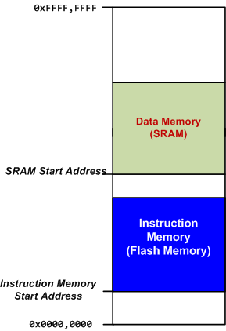
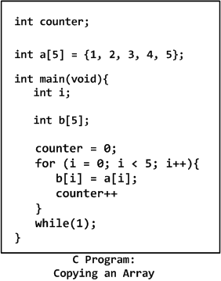

Loading Code and Data into Memory

Slide 103
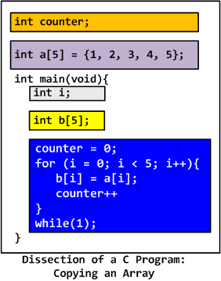
Loading Code and Data into Memory

Slide 104
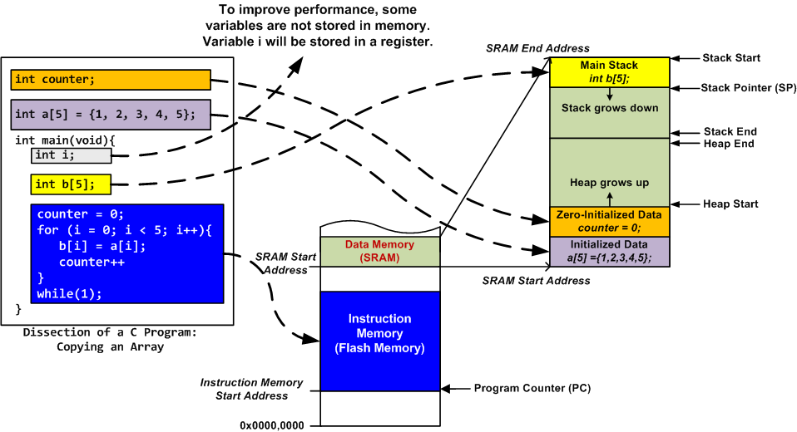
Loading Code and Data into Memory
Stack is mandatory
Heap is used only if dynamic allocation (e.g. malloc, calloc) is used.

